Slide 1
Elasticsearch
Lecturer: Ngo Huy Bien
Software Engineering Department
Faculty of Information Technology
VNUHCM - University of Science
Ho Chi Minh City, Vietnam
nhbien@fit.hcmus.edu.vn

Slide 2

Objectives

Slide 3

Contents

Slide 4

References
Pranav Shukla, Sharath Kumar M N (2017). Learning Elastic Stack 6.0. Packt Publishing.

Slide 5
What is Elasticsearch? [1]
Elasticsearch is a realtime, distributed search and analytics engine that is horizontally scalable and capable of solving a wide variety of use cases. At the heart of Elastic Stack, it centrally stores your data so you can discover the expected and uncover the unexpected.
Any application that needs to find the most relevant item from millions or billions of items can use Elasticsearch to solve this problem.

Slide 6
1. Install Elasticsearch
Download the ZIP distribution.
https://www.elastic.co/downloads/elasticsearch
Extract the file and add C:\elasticsearch-7.5.1\bin to your PATH
Run
elasticsearch
Run
curl http://localhost:9200

Slide 7
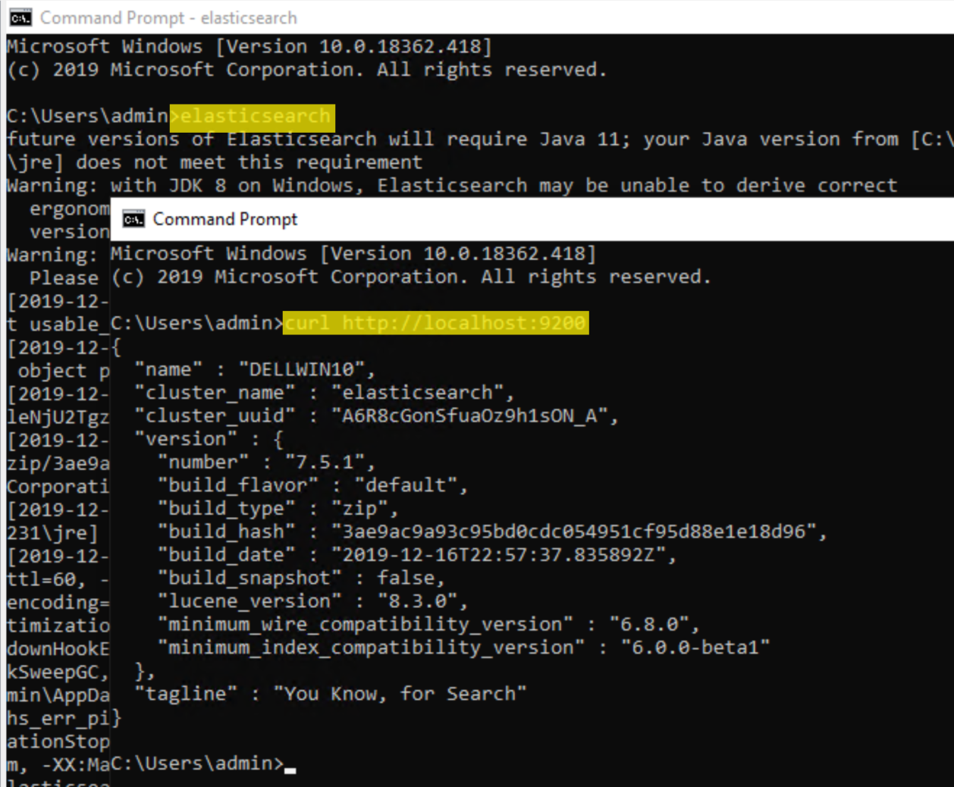
2. Verify Elasticsearch Install

Slide 8
3. Install Kibana
Download the ZIP distribution.
https://www.elastic.co/downloads/kibana
Extract the file and add C:\kibana-7.5.1-windows-x86_64\bin to your PATH
Run
kibana
Open the URL http://localhost:5601 in your favorite browser.

Slide 9
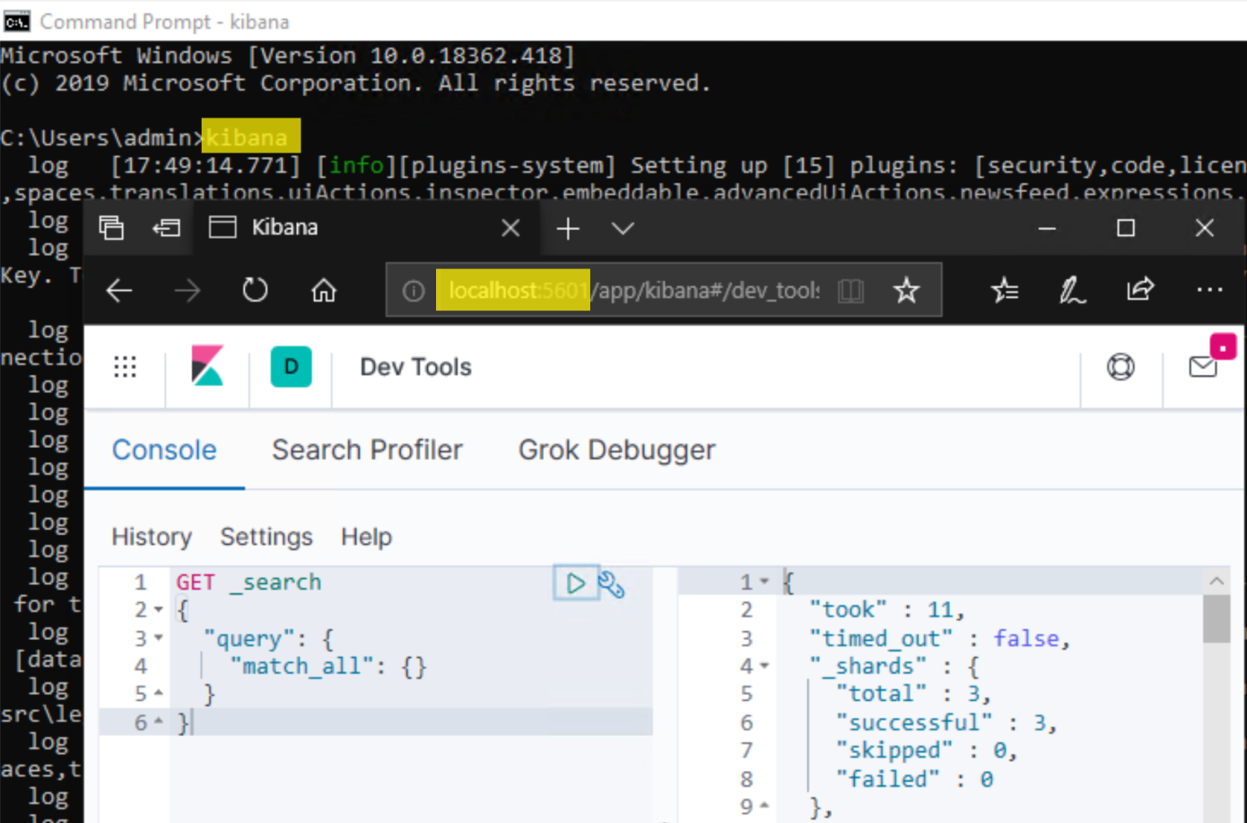
4. Verify Kibana Install

Slide 10
5. Put Document
PUT /catalog/_doc/1
{
"sku": "SP000001",
"title": "Elasticsearch for Hadoop",
"description": "Elasticsearch for Hadoop",
"author": "Vishal Shukla",
"ISBN": "1785288997",
"price": 26.99
}

Slide 11
Respone
{
"_index" : "catalog",
"_type" : "_doc",
"_id" : "1",
"_version" : 1,
"result" : "created",
"_shards" : {
"total" : 2,
"successful" : 1,
"failed" : 0
},
"_seq_no" : 0,
"_primary_term" : 1
}

Slide 12
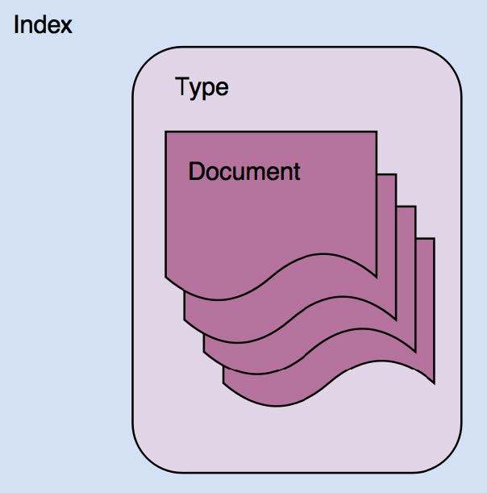
Indexes
An index is a container that stores and manages documents of a single type in Elasticsearch.
An index can contain documents of a single Type, as depicted in the following diagram:

Slide 13
Types
An index is a logical container of a type.
Some configuration parameters are defined at the index level, while other configuration parameters are defined at the type level.
Typically, documents with mostly common sets of fields are grouped under one type.
Elasticsearch is schemaless, allowing you to store any JSON document with any set of fields into a type.

Slide 14
Documents
A document consists of multiple fields and is the basic unit of information that's stored in Elasticsearch.
Each field in the JSON document is of a particular type.

Slide 15


Slide 16
1. Install Elasticsearch on Ubuntu
sudo apt-get install wget
wget -qO - https://artifacts.elastic.co/GPG-KEY-elasticsearch | sudo apt-key add -
sudo apt-get install apt-transport-https
echo "deb https://artifacts.elastic.co/packages/7.x/apt stable main" | sudo tee /etc/apt/sources.list.d/elastic-7.x.list
sudo apt-get update
sudo apt-get install elasticsearch

Slide 17
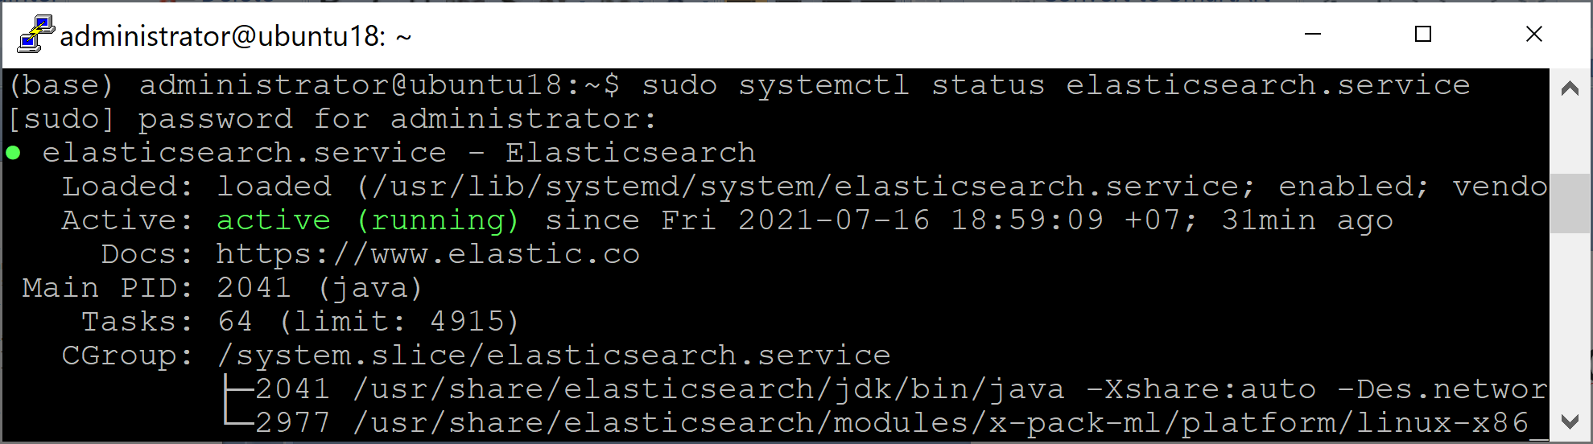
2. Configure Network Host
sudo nano /etc/elasticsearch/elasticsearch.yml
network.host: 192.168.1.19
#discovery.seed_hosts: ["host1", "host2"]
discovery.type: single-node
sudo /bin/systemctl daemon-reload
sudo /bin/systemctl restart elasticsearch.service
sudo systemctl status elasticsearch.service
sudo /bin/systemctl enable elasticsearch.service

Slide 18
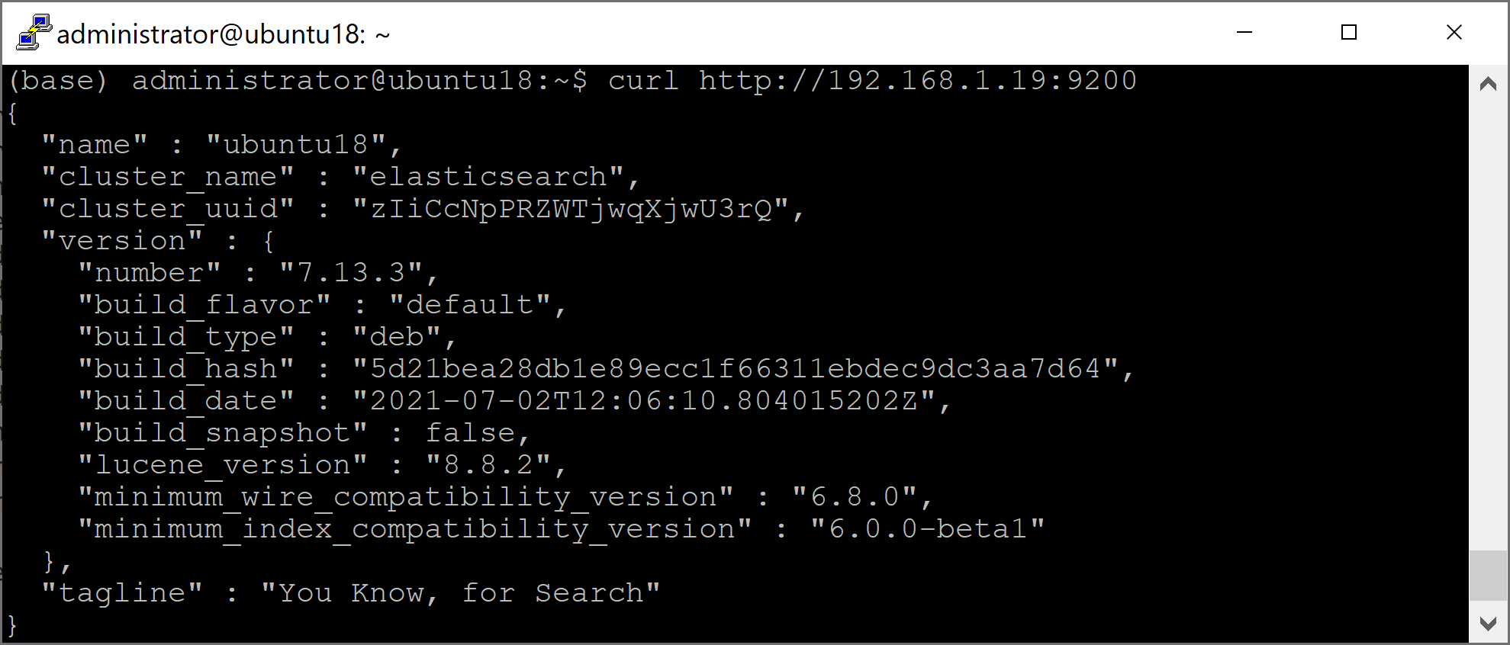
3. Verify Elasticsearch Install
curl http://192.168.1.19:9200

Slide 19
4. Configure Data Location
sudo chmod a+w /data
mkdir /data/elasticsearch
sudo chown -R elasticsearch:elasticsearch /data/elasticsearch
sudo nano /etc/elasticsearch/elasticsearch.yml
path.data: /data/elasticsearch
sudo /bin/systemctl restart elasticsearch.service
sudo systemctl status elasticsearch.service

Slide 20

Thank You & See You Again

